Slide 1



Pythonic Chat: Building a Command Line Chatroom

Slide 2

Introduction
Python is a powerful programming language that can be used for various purposes, including creating chatrooms. In this presentation, we will explore the process of creating a command line based chatroom using Python.
The chatroom will allow multiple users to communicate with each other in real-time, making it an ideal solution for teams or groups who need to collaborate remotely.

Slide 3

Lightweight: Command line chatrooms are generally very lightweight and don't require a lot of system resources to run. This makes them ideal for use on older or less powerful computers, as well as on servers with limited resources. Fast: Command line chatrooms are often faster than their graphical counterparts because they don't have to render any graphics or animations. This means that they can be used on slower internet connections or on devices with limited bandwidth. Customizable: Command line chatrooms can be highly customizable, as they can be easily scripted and automated using shell scripts and other tools. This makes it possible to automate repetitive tasks, such as sending messages or performing searches. Secure: Command line chatrooms are generally more secure than graphical chatrooms because they are less susceptible to attacks from malicious software. Additionally, because they don't require a graphical interface, they are less vulnerable to phishing attacks or other forms of social engineering. Portable: Command line chatrooms can be used on a wide variety of devices and operating systems, as they don't require any special software or drivers to run. This means that they can be used on everything from desktop computers to smartphones, making them highly versatile and convenient.
ADVANTAGES OF COMMAND LINE CHATROOM

Slide 4

Setting up the Environment
Before we begin developing our chatroom, we need to set up our environment. We will be using Python 3 and some external libraries such as socket and threading.
We will also need to create a server and client script that will handle the communication between users. Once our environment is set up, we can move on to developing our chatroom.

Slide 5

Future Scope
Integration with other tools: Command line chatrooms will become more integrated with other command line tools, making it easier to automate and streamline tasks, share information, and work more efficiently across teams and organizations.
Continued relevance: Command line chatrooms will remain relevant in the future as they provide a lightweight and customizable way to communicate and collaborate in various settings, such as software development and scientific research.

Slide 6
PROGRAM
except:
index = clients.index(client)
clients.remove(client)
client.close()
nickname = nicknames[index]
broadcast('{} left!'.format(nickname).encode('ascii'))
nicknames.remove(nickname)
break
def receive():
while True:
client, address = server.accept()
print("Connected with {}".format(str(address)))
client.send('NICKNAME'.encode('ascii'))
nickname = client.recv(1024).decode('ascii')
nicknames.append(nickname)
clients.append(client)
print("Nickname is {}".format(nickname))
broadcast("{} joined!".format(nickname).encode('ascii'))
client.send('Connected to server!'.encode('ascii'))
thread = threading.Thread(target=handle, args=(client,))
thread.start()
receive()
Server Code:
import socket, threading
host = '127.0.0.1'
port = 7976
server = socket.socket(socket.AF_INET,
socket.SOCK_STREAM)
server.bind((host, port))
server.listen()
clients = []
nicknames = []
def broadcast(message):
for client in clients:
client.send(message)
def handle(client):
while True:
try:
message = client.recv(1024)
broadcast(message)

Slide 7
Client Code:
import socket, threading
nickname = input("Choose your nickname: ")
client = socket.socket(socket.AF_INET, socket.SOCK_STREAM)
client.connect(('127.0.0.1', 7976))
def receive():
while True:
try:
message = client.recv(1024).decode('ascii')
if message == 'NICKNAME':
client.send(nickname.encode('ascii'))
else:
print(message)
except:
print("An error occured!")
client.close()
break
def write():
while True:
message = '{}: {}'.format(nickname, input(''))
client.send(message.encode('ascii'))
receive_thread = threading.Thread(target=receive)
receive_thread.start()
write_thread = threading.Thread(target=write)
write_thread.start()

Slide 8
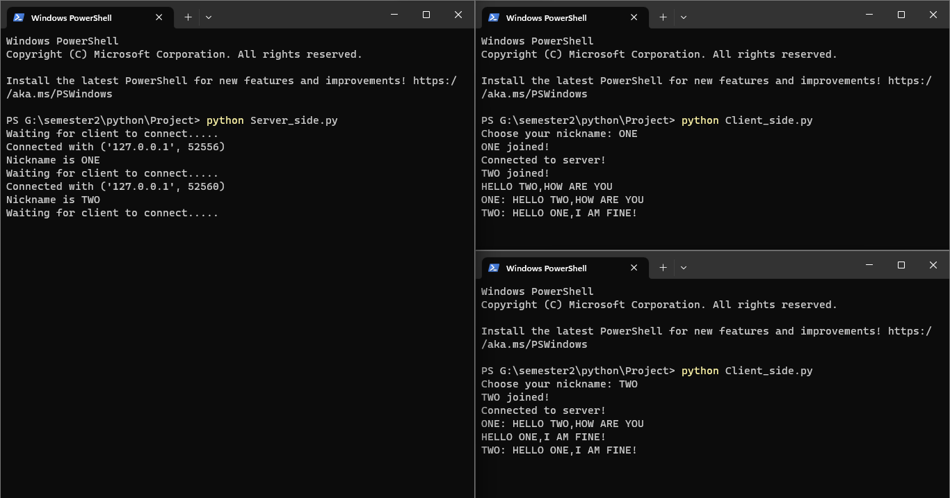
OUTPUT

Slide 9

CONCLUSION
In conclusion, creating a command line based chatroom using Python is a relatively simple process that can be accomplished with just a few lines of code. By using the socket and threading libraries, we can create a chatroom that allows multiple users to communicate in real-time.
With further development, we can add features like private messaging, file sharing, and more. Overall, creating a chatroom using Python is a fun and rewarding project that can help improve our programming skills.

Slide 10

THANK YOU

